Slide 1
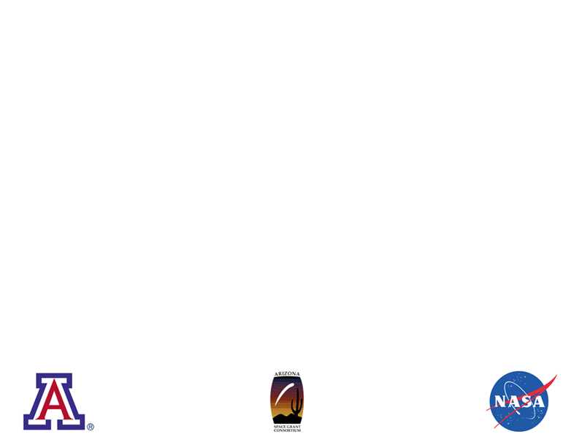
A Systematic Survey of
High-Mass Infall Candidates
Follow-up Observations of BGPS Sources
with Galactic Longitudes 29.0° ≤ ℓ ≤ 31.0°
Matthew Lichtenberger¹
Advisor: Dr. Yancy Shirley^{1,2}
April 12, 2014
¹Steward Observatory, 933 North Cherry Avenue, Tucson, AZ 85721, USA
²Adjunct Astronomer, The National Radio Astronomy Observatory

Slide 2
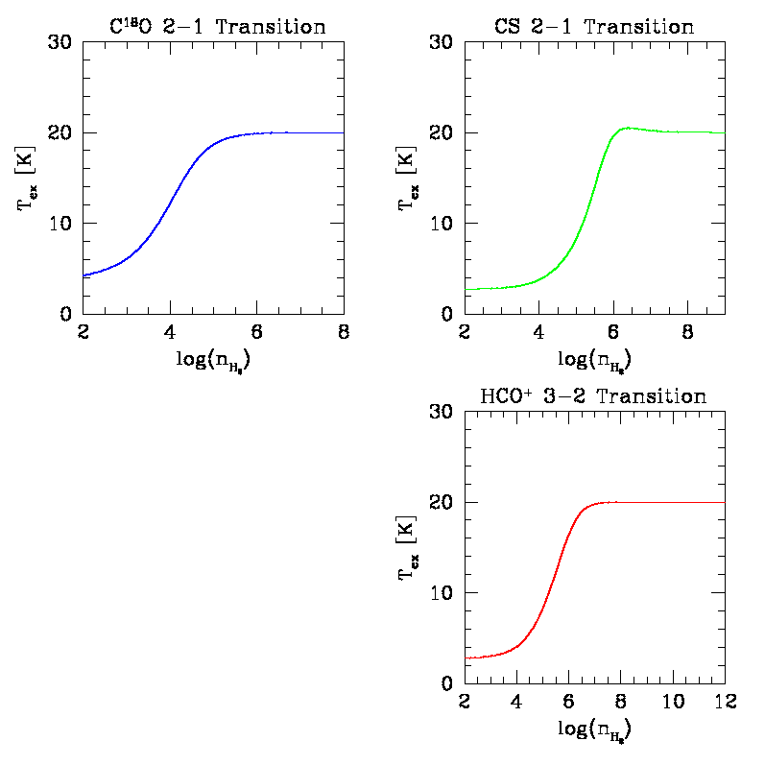
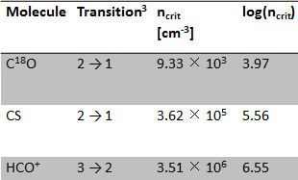
Theory
Curves were evolved using RADEX¹ and plotted using SuperMongo²
C¹⁸O as tracer of less dense gas due to n_{crit} or n_{therm}
¹Van der Tak, F.F.S., Black, J.H.,
Schöier, F.L., Jansen, D.J., van
Dishoeck, E.F., 2007, A&A 468,
627-635
²Lupton & Monger
³Leiden Atomic and Molecular
Database, Schöier, F.L., van der Tak,
F.F.S., van Dishoeck E.F., Black, J.H.
2005, A&A 432, 369-379

Slide 3
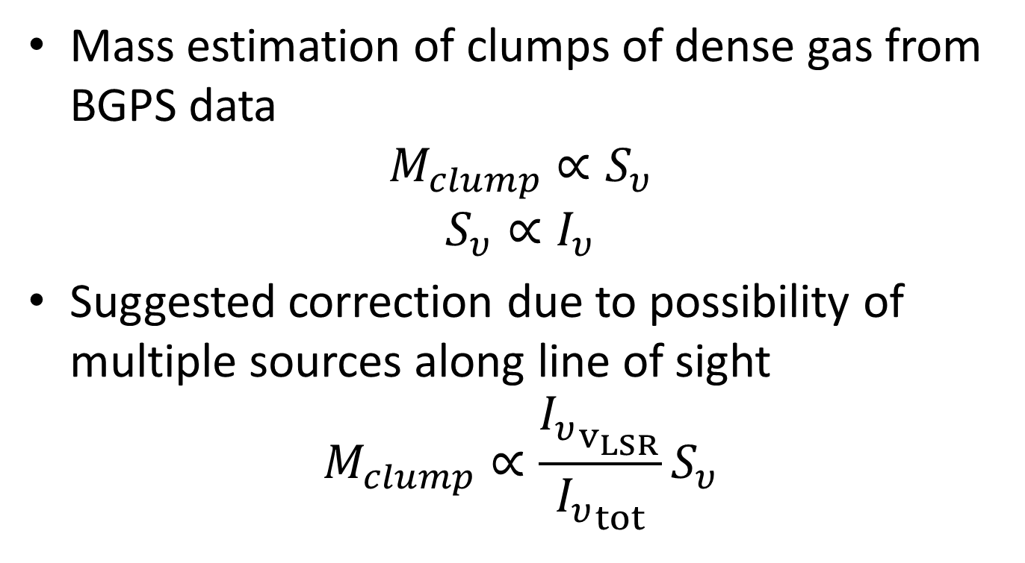
Theory, continued
Mass estimation of clumps of dense gas from BGPS data
$$M_{clump}∝S_{υ}$$
$$S_{υ}∝I_{υ}$$
Suggested correction due to possibility of multiple sources along line of sight
$$M_{clump}∝\frac{{I_{υ}}_{v_{LSR}}}{{I_{υ}}_{tot}}S_{υ}$$

Slide 4
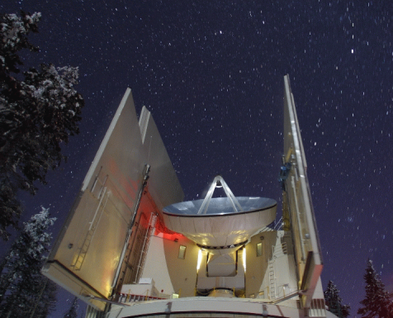
Observing
Submillimeter Telescope, Mount Graham
Observing frequency of 219.5603541 GHz
Five observing shifts
Two off positions used
Image credit: Yancy Shirley

Slide 5
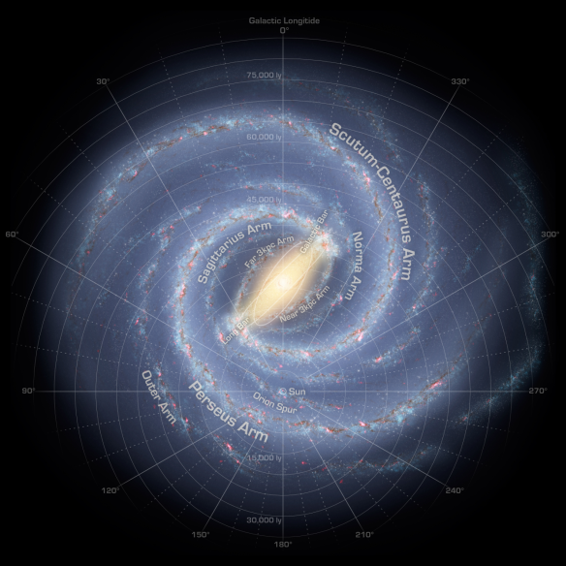
Direction of sources along Scutum-Centaurus Arm towards Sagittarius Arm
Image taken from the NASA Solar System Exploration Multimedia Gallery

Slide 6
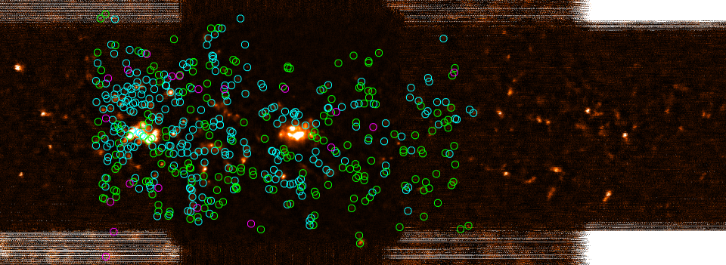
Targets
Image credit: BOLOCAM GPS
v2 release

Slide 7
Results
Detection fraction: 95.05% of the total sample of sources had at least one C¹⁸O velocity component detected
41.44% of the sample had a unique C¹⁸O detection

Slide 8
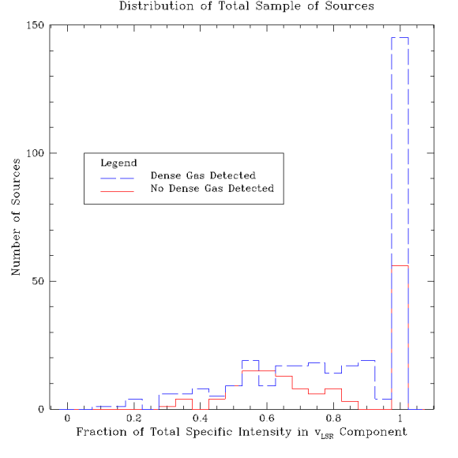
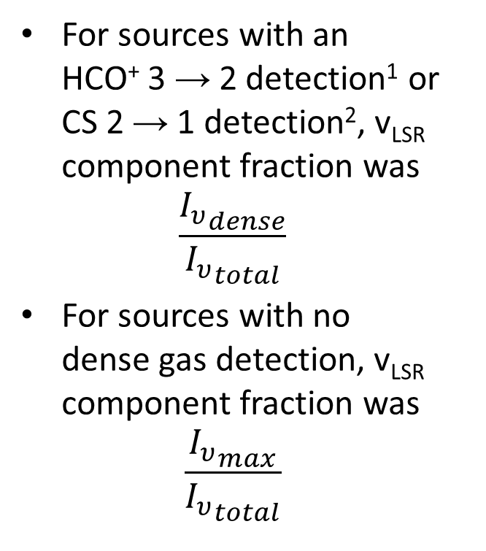
For sources with an HCO⁺ 3 → 2 detection¹ or CS 2 → 1 detection², v_{LSR} component fraction was
$$\frac{{I_{υ}}_{dense}}{{I_{υ}}_{total}}$$
For sources with no dense gas detection, v_{LSR} component fraction was
$$\frac{{I_{υ}}_{max}}{{I_{υ}}_{total}}$$
¹Shirley et al 2013
²University of Arizona
Astronomy Club
(in preparation)

Slide 9
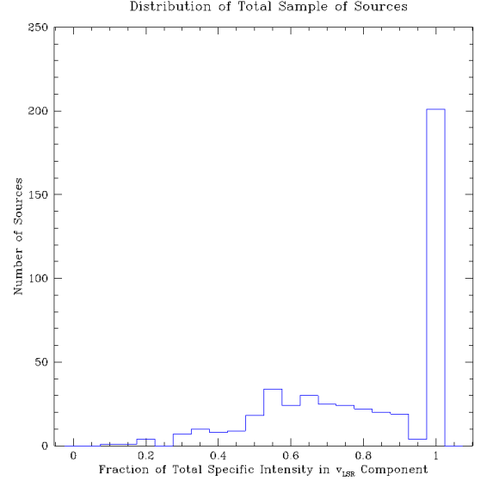
Main peak due to single detections, secondary peak due to multiple detections
Weighted mean correction to mass calculation is reduction by 18.8%
Median correction to mass calculation is reduction by 14.2%

Slide 10
Conclusions
Multiple sources along the line of sight need to be accounted for, or else a non-negligible error will be made in mass estimates
Possible future activities: investigating other regions of the galactic plane, checking against additional density tracers

Slide 11
Acknowledgements
Dr. Yancy Shirley
Steward Observatory
SMT Observing & Maintenance Staff
Ms. Susan Brew, Dr. Barron Orr, & the NASA Space Grant Program
Today’s audience – thank you for your time and attention

